Slide 1
INFO 697 - Rapid Prototyping and Physical Computing
Week 1 – Intro to making and physical computing

Slide 2

Introductions

Slide 3
Instructors
Dr. Monica Maceli
Basem Aly
Associate Professor at School of Information
Information technologies
Teaching and research interests:
Technology education, emerging tech in the information professions, applications of microcontrollers/single-board computers in GLAM
Associate Director of Research and Strategic Projects, IT
Teaching and research interests:
Game Design & VR
Information Theory/ Cybernetics
Hacking (remote control, hybrid games, etc.)

Slide 4
Who are you?
Out loud:
Your name (or what you would prefer to be called)
One fun thing you did over the break OR one interesting fact about you
On the notecard:
Your name
Degree program & career interests (if known!)
What experience you have with programming, if any?
What is your primary computer? Do you bring this to class typically? (i.e. Mac laptop)

Slide 5
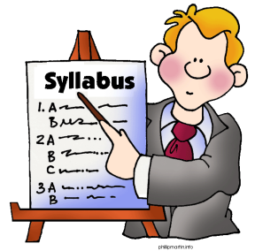
Syllabus
Course description/outcomes, assignments & grading, policies, and schedule of topics

Slide 6

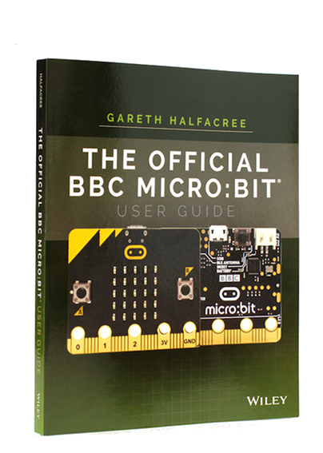

Slide 7
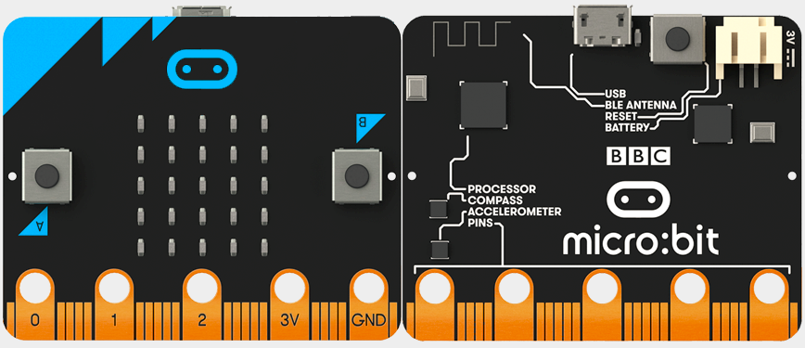
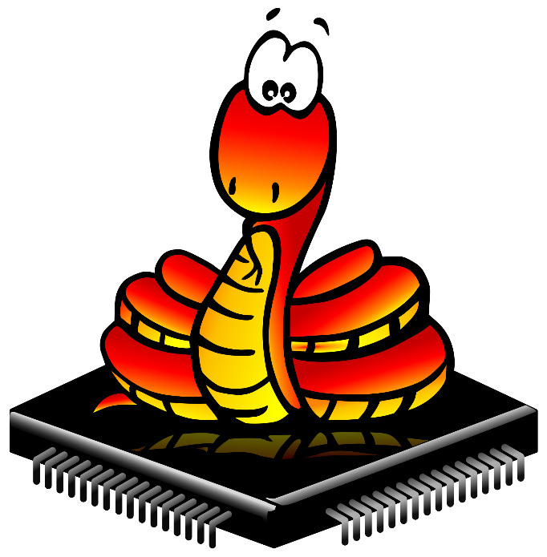

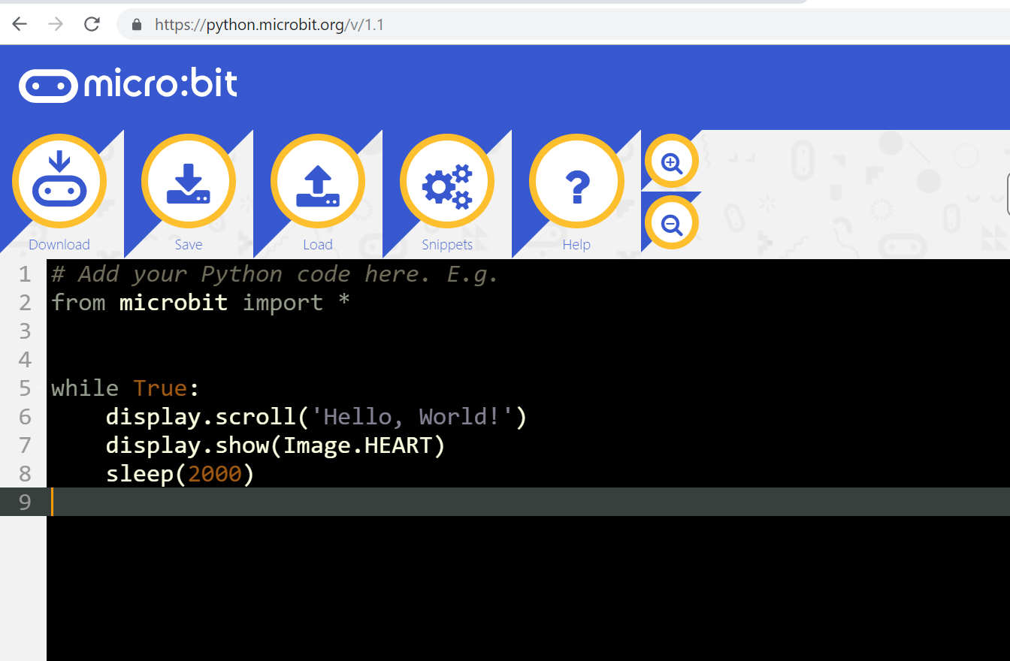


Slide 8

Lms.pratt.edu
Where to find lectures and other materials and assignment submission

Slide 9
Weekly Class Structure
Part 1:
Lecture and/or discussion of reading material, question and answers, project brainstorming, design activities, guest speaker, and/or field trips.
Break:
20 minutes
Part 2:
Introduction to new technical material and hands-on lab. Bring your own materials (Micro:Bit and accessories) to complete the activities! (There will be a few extras available if needed). Bring a USB drive or save your work to the cloud (e.g. Google Drive, Dropbox).

Slide 10
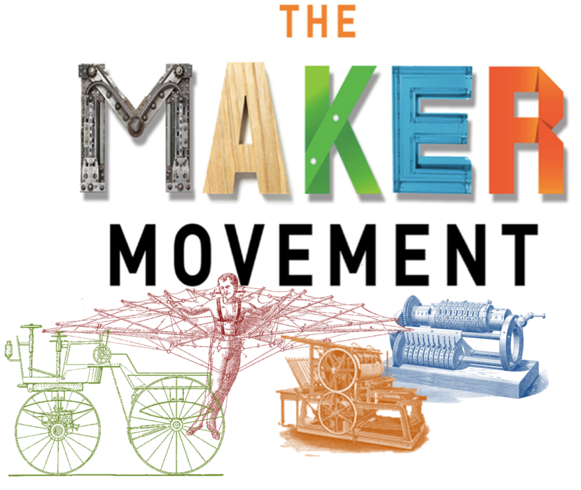
How did we get here?

Slide 11
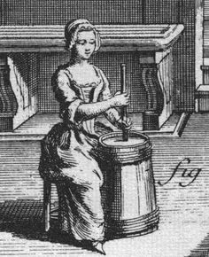
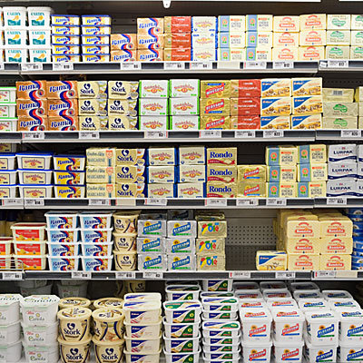
Makers
Consumers

Slide 12
The Maker Culture
“Maker culture emphasizes learning-through-doing (active learning) in a social environment. Maker culture emphasizes informal, networked, peer-led, and shared learning motivated by fun and self-fulfillment.”
Source: Wikipedia - https://en.wikipedia.org/wiki/Maker_culture

Slide 13


Slide 14
What do makers make?
3D Printing objects
Computer programs
Digital media
Photography
Software
Hardware
Robotics
Jewelry
Food
Wood works
Clothing
Knitted items
Paper Crafts
Legos & other building blocks
Etc.

Slide 15
Utopian Vision
Making is often articulated in utopian terms
It is envisioned to democratize technology production
Critics question the inherent technosolutionism
i.e. can technology solve complex sociocultural problems? Is this unrealistic and/or naïve?

Slide 16
How does “making” fit into our design practices?
We’ll consider this from a variety of theoretical perspectives, both in our readings and hands-on work with physical computing throughout the term
Including:
Design thinking
Critical making
Material speculation
Open and inclusive design
And others…!

Slide 17
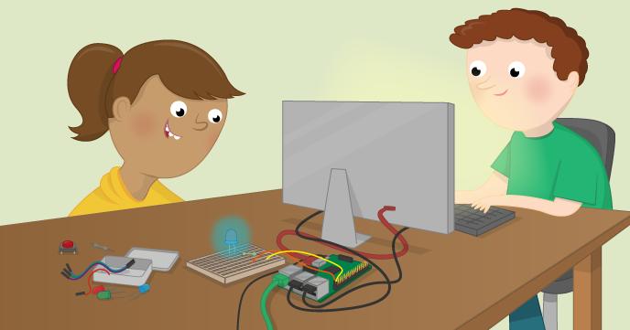
Physical computing
Bridging the gap between the physical and virtual

Slide 18
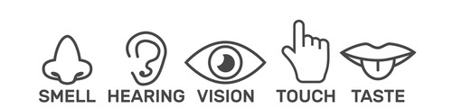
Humans and Machines
Our bodies and abilities define how we can “talk” to devices (input)
Our sensory system defines how we can “listen” to devices (output).

Slide 19
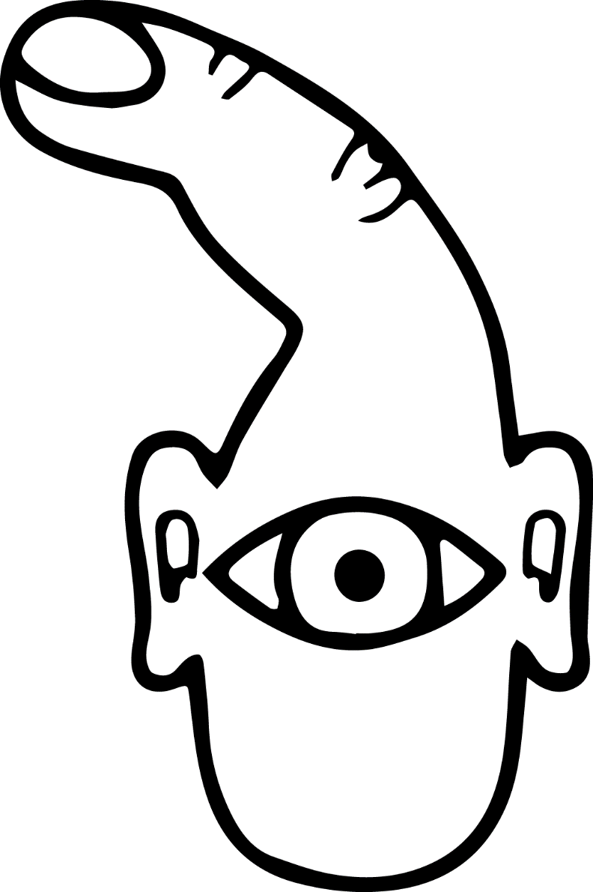
Is this still accurate?
Why?
“How the computer sees us” from Physical Computing (image: Tom Igoe, Dan O’Sullivan)

Slide 20
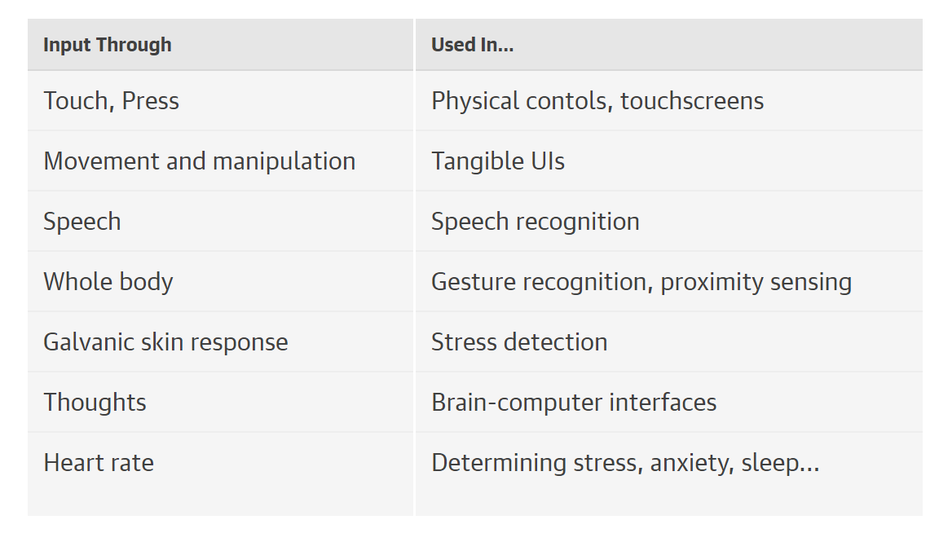
INPUT: Ways of sensing human physical energy and expressions.
Charlier, M. (2015). Designing Connected Products: UX for the Consumer Internet of Things.

Slide 21
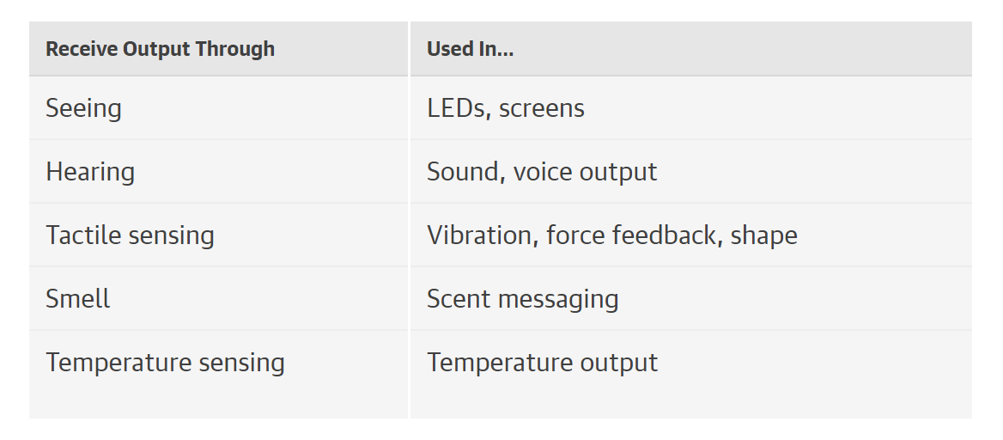
OUTPUT: Computer changes the world in some way, e.g. moving something, making a sound, etc.
Charlier, M. (2015). Designing Connected Products: UX for the Consumer Internet of Things.

Slide 22
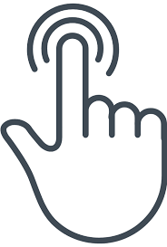
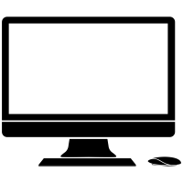
Physical Computing
A conversation between the physical world and the virtual world of the computer
Transduction, the conversion of one form of energy into another
Transduction
Physical energy
Electrical Signals

Slide 23
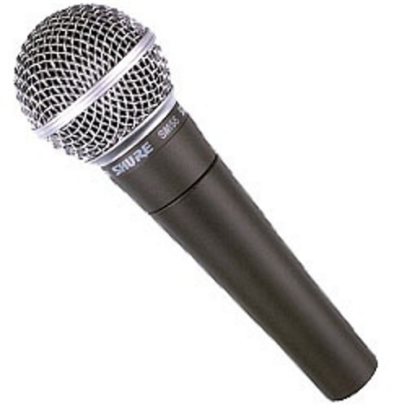
A Transducer
What does this do?
A microphone converts sound into an electrical signal

Slide 24
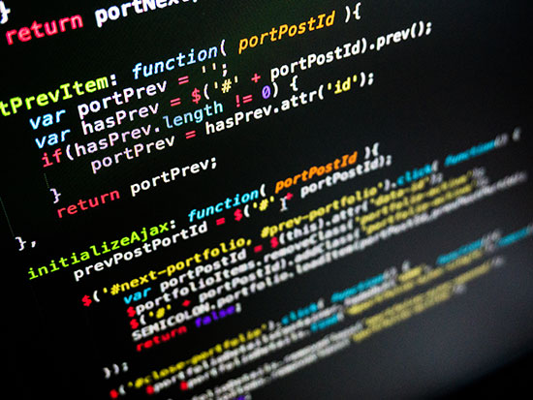
Interaction: Input, Output, and Processing
A computer converts the changes in energy given off by our bodies, in the form of heat, light, sound, and so forth, into changing electronic signals that it can interpret
Sensors facilitate this transduction process
Very simple computers, called microcontrollers, read sensors and convert their output into data
Input and output are the physical parts of physical computing.
Processing requires a computer to read the input, make decisions based on the changes it reads, and activate outputs.

Slide 25
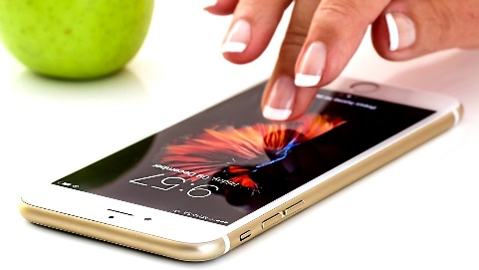
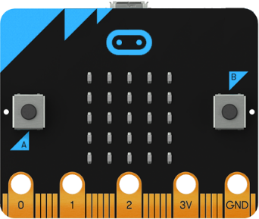
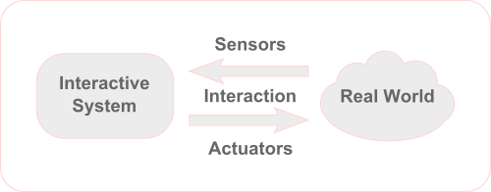
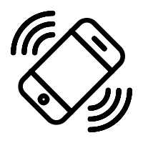
Physical Computing
An actuator is a component of a machine that is responsible for moving and controlling a mechanism or system, aka a "mover"

Slide 26
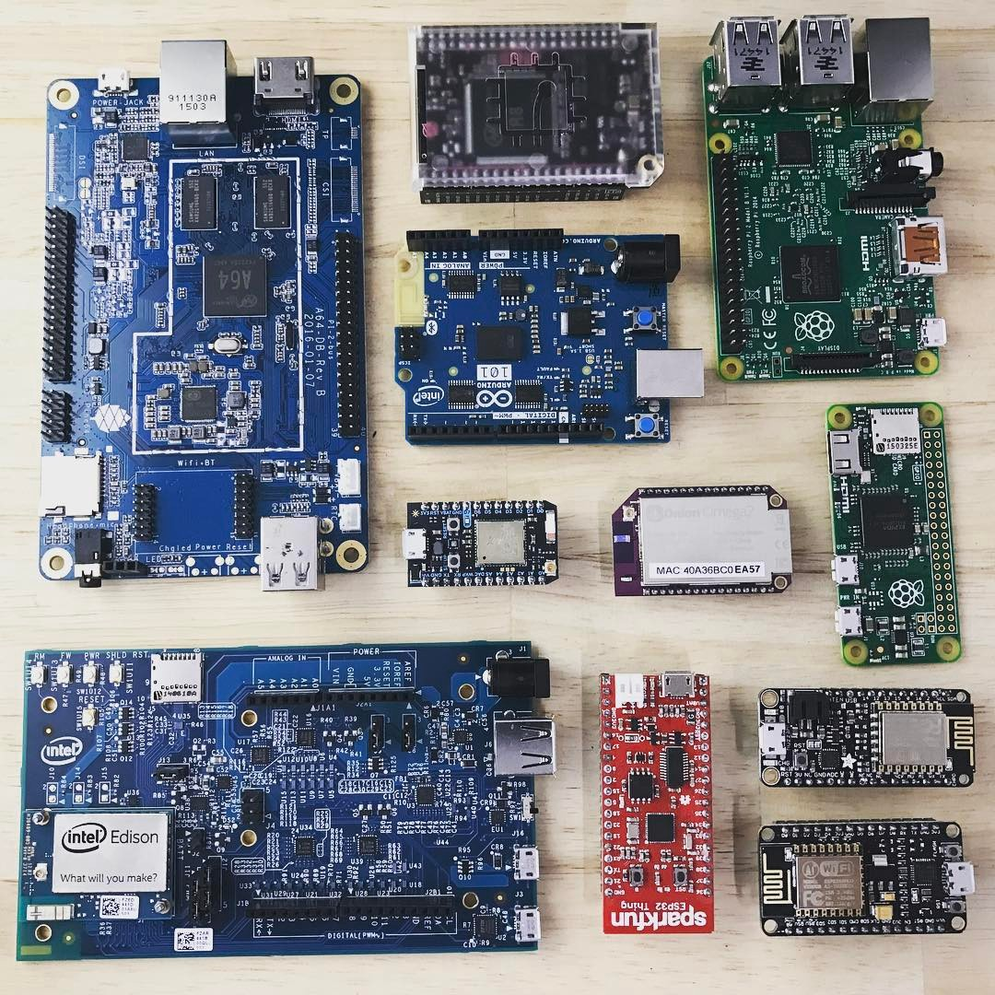
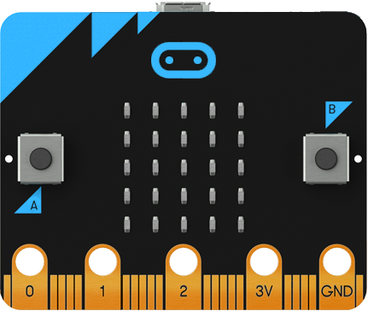
Microcontroller basics

Slide 27

Microcontrollers
Serve as the gateway between the physical and the virtual
Handle input/output/processing by:
Receiving information from sensors,
controlling basic motors and other devices that create physical change, and
sending information to computers and other devices.

Slide 28
Arduino and Alternatives
Arduino is an “open-source electronics prototyping platform based on flexible, easy-to use hardware and software”
Very popular single board microcontrollers with extensive community support, tutorials, and hardware for purchase
There are many, many other microcontroller and single-board computer devices for DIY projects!
E.g. Adafruit’s Feather development boards
Raspberry Pi is a popular series of small single-board computers
Single-board computers are a tiny version of a full-fledged computer with CPU, RAM, ports, display output, secondary storage, etc.

Slide 29
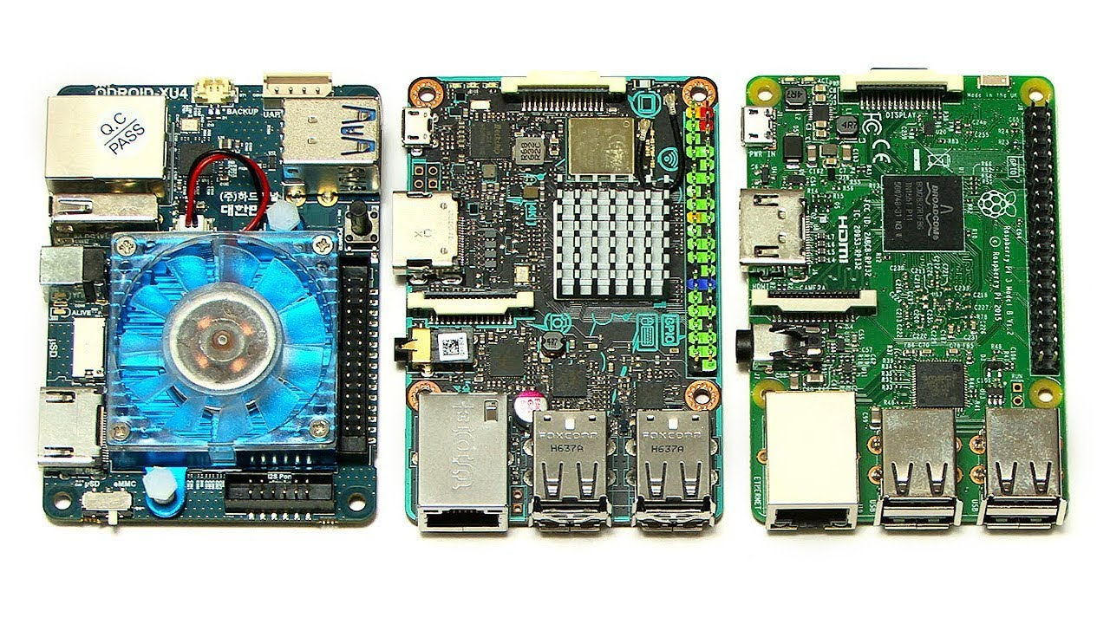
Odroid, Asus Tinker Board, Raspberry Pi

Slide 31
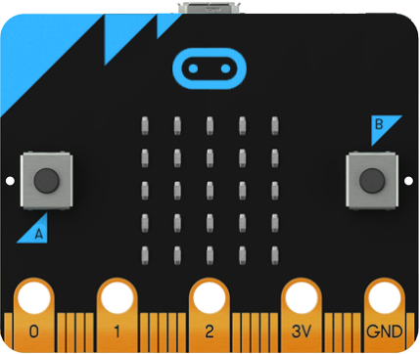
The Micro:Bit
Nordic nRF51822 – 16 MHz 32-bit ARM Cortex-M0 microcontroller, 256 KB flash memory, 16 KB static ram, 2.4 GHz Bluetooth low energy wireless networking.
No WiFi?!?
NXP/Freescale KL26Z – 48 MHz ARM Cortex-M0+ core microcontroller
NXP/Freescale MMA8652 – 3-axis accelerometer sensor via I²C-bus.
NXP/Freescale MAG3110 – 3-axis magnetometer sensor via I²C-bus (to act as a compass and metal detector).
MicroUSB connector, battery connector, 23-pin edge connector for connecting other sensors!
Display consisting of 25 LEDs in a 5×5 array.
Three tactile pushbuttons (two for user, one for reset)

Slide 32
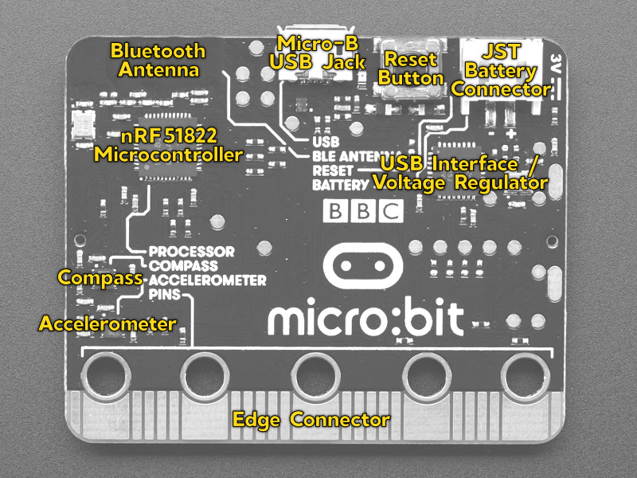

Slide 33
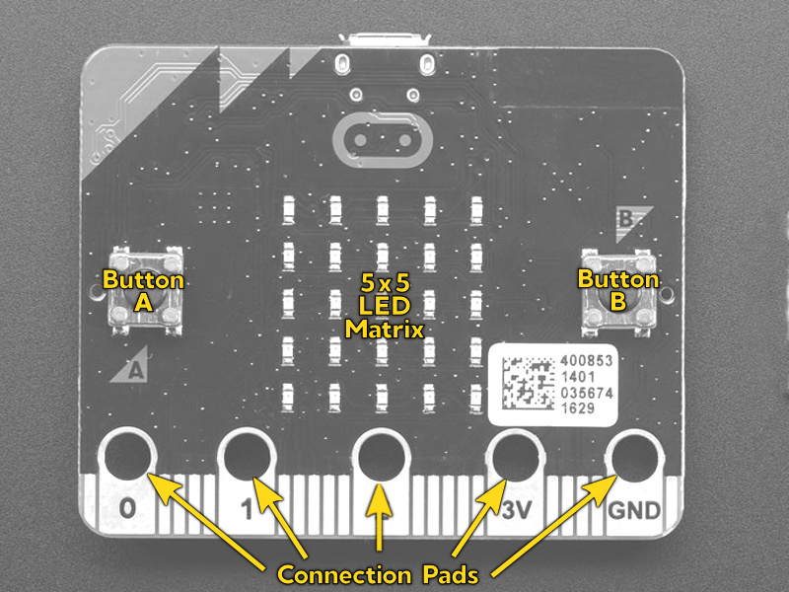

Slide 34
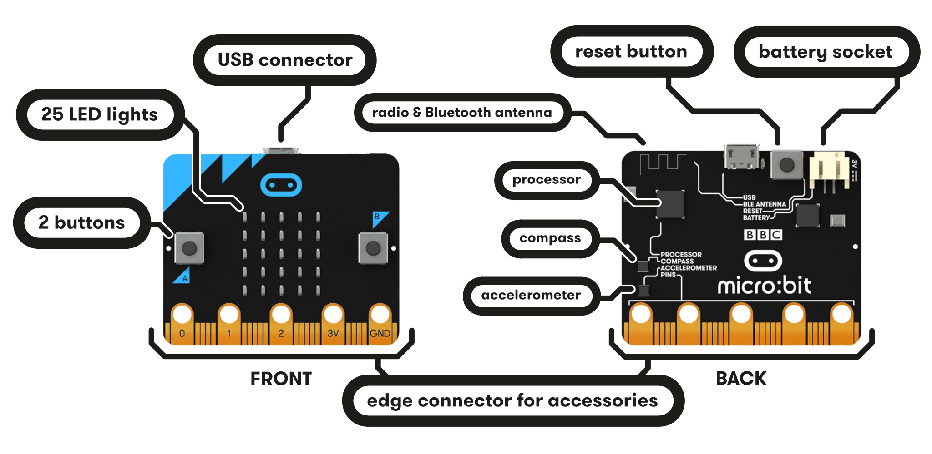
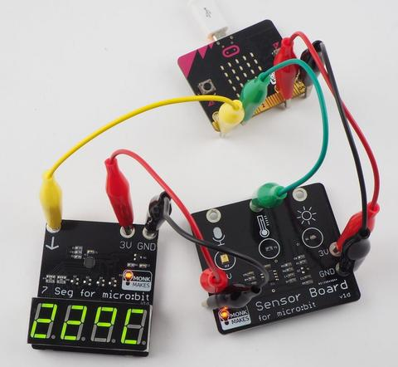
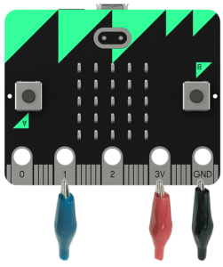

Slide 35
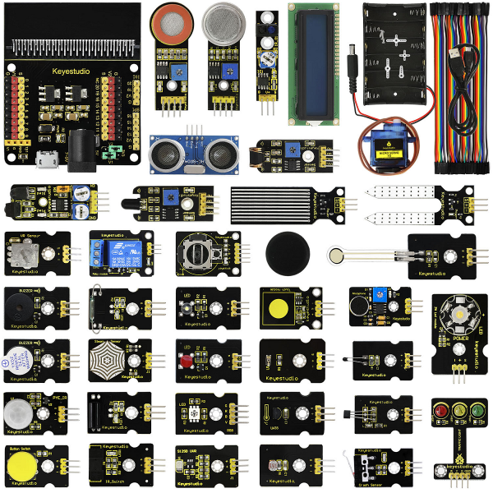
keyestudio 37 in 1 Starter Kit for BBC micro:bit
Documentation and code examples:
https://wiki.keyestudio.com/KS0361(KS0365)_keyestudio_37_in_1_Starter_Kit_for_BBC_micro:bit

Slide 36
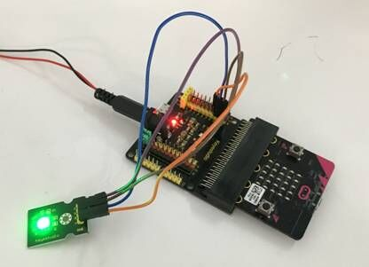
Micro:Bit and Sensor Shield

Slide 37
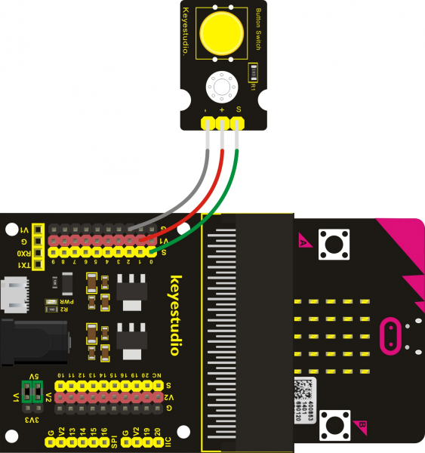
Shields?
Connect shield USB or battery pack for more power
Connect USB to program the MB
Allows us to easily use all pins on the MicroBit
Allows us to power sensors requiring 5v power (MB alone puts out 3.3v)

Slide 38
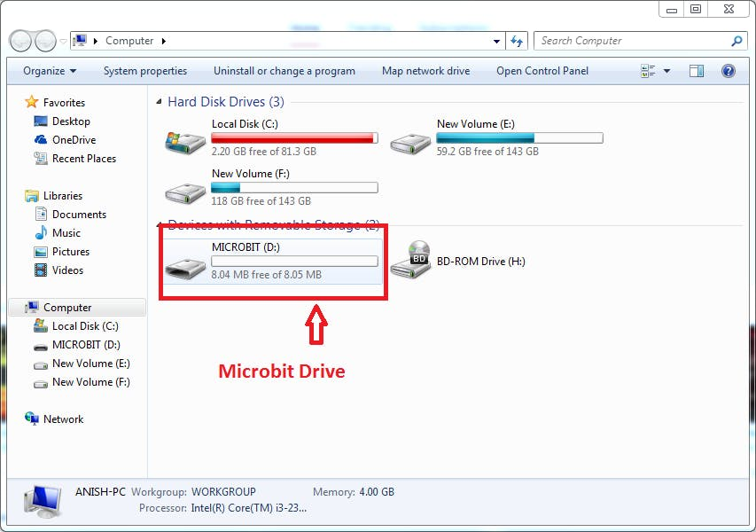
Programming the Micro:Bit
Micro:bit was designed for easy coding education with two main options for novices:
JavaScript Blocks Editor - drag and drop visual blocks, i.e. visual programming language
Python Editor - write code in Python
Also, Microsoft MakeCode (drag-n-drop block programming or Javascript), micropython, mbed, or Arduino…
Web-based, mobile, and desktop code editor options
Behaves and looks just like a USB thumb drive to your computer (Mac, PC, etc.)
No additional software or drivers need to be installed!

Slide 39
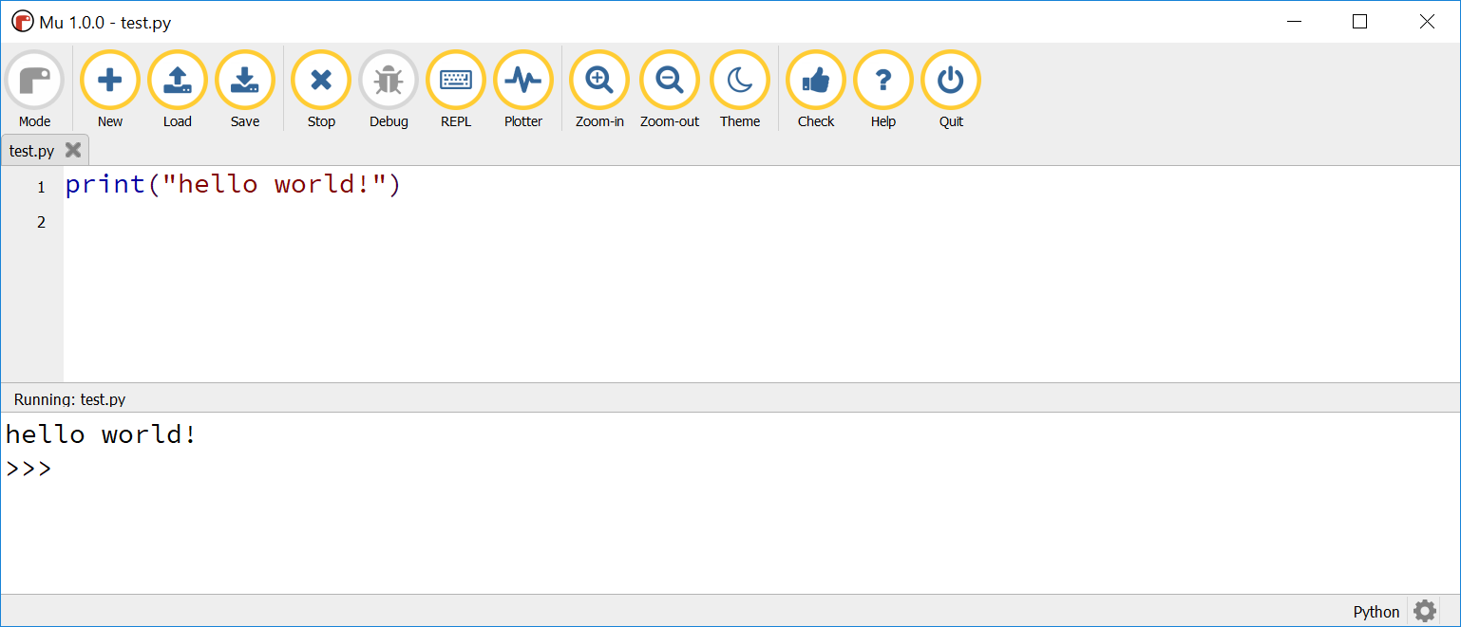
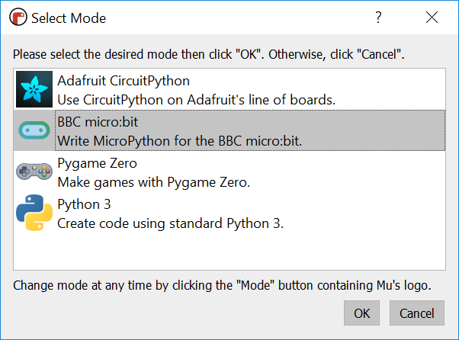
The Mu Python code editor
https://codewith.mu/en/download

Slide 40
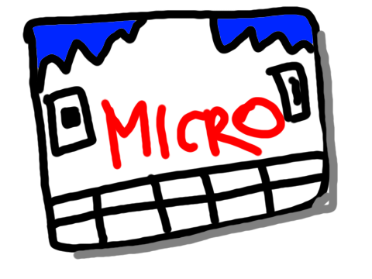
micro:bit exercises
Programming the Micro:Bit

Slide 41
Introductory MicroPython Tutorials
The classic “Hello World” https://microbit-micropython.readthedocs.io/en/latest/tutorials/hello.html
Also try this with the MakeCode visual editor -> https://makecode.microbit.org/#lang=en
Showing image on the LEDs https://microbit-micropython.readthedocs.io/en/latest/tutorials/images.html
Responding to gestures https://microbit-micropython.readthedocs.io/en/latest/tutorials/gestures.html
Putting it all together!
Show a smiley face unless the device is shaken, then show the unhappy face
Bonus – show a randomly selected face anytime you shake the device

Slide 42
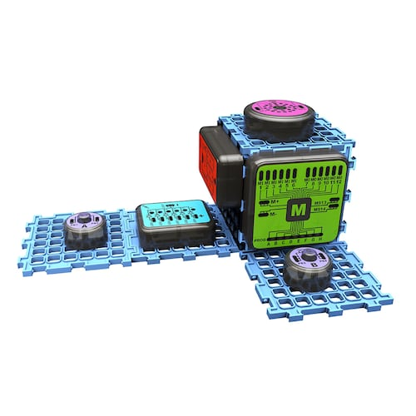
Games & gadgets electronic lab
Play time!

Slide 43
For Next Week
Do readings
Purchase the keyestudio 37 in 1 Starter Kit for BBC micro:bit
Install the Mu code editor (https://codewith.mu/en/download)
When you get your MicroBit, use Mu to practice loading one of today’s examples onto your to test it out

